Slide 1
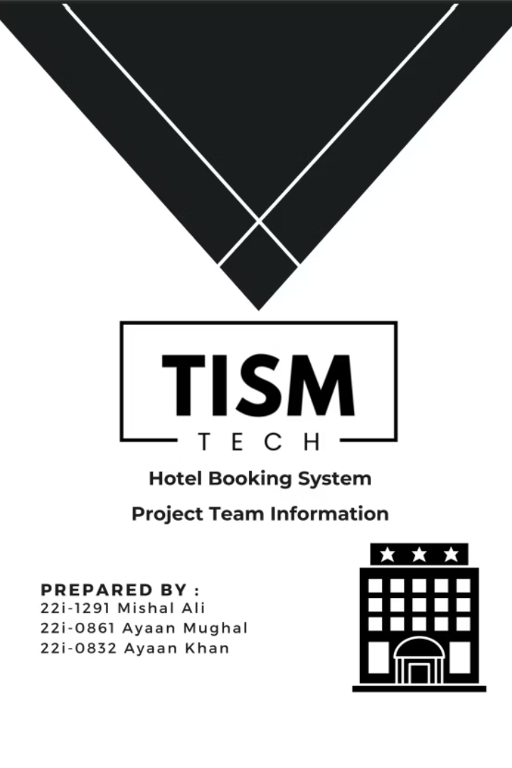
Hotel Booking System
TISM Tech: Ayaan Khan, Ayaan Mughal, Mishal Ali
Software Engineering, Spring 2025

Slide 2
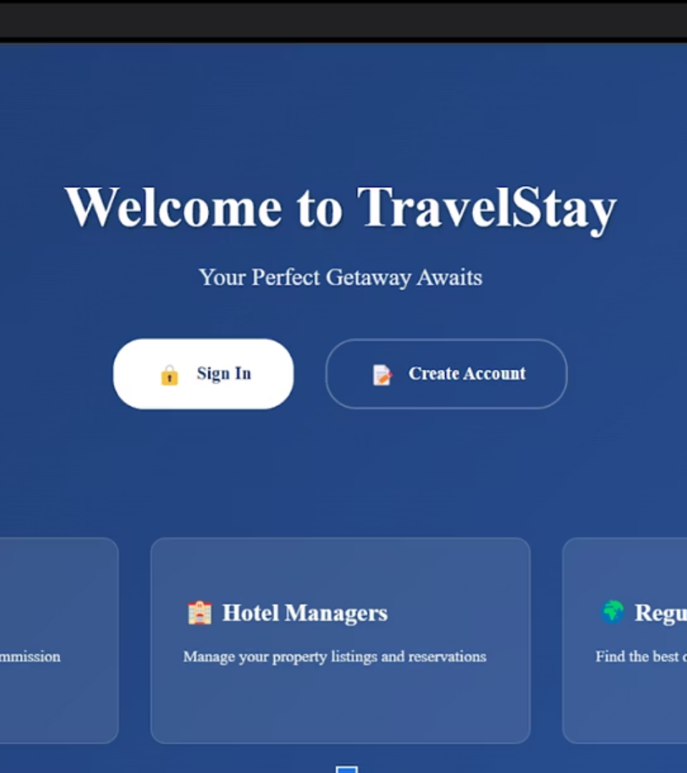




System Overview
Web-based Platform
Microservices-based using MERN stack for hotel reservations
Guest Experience
Simplified search, book, manage workflow
Hotel Management
Real-time inventory and pricing controls
Travel Agents
Support for bulk and group bookings

Slide 3
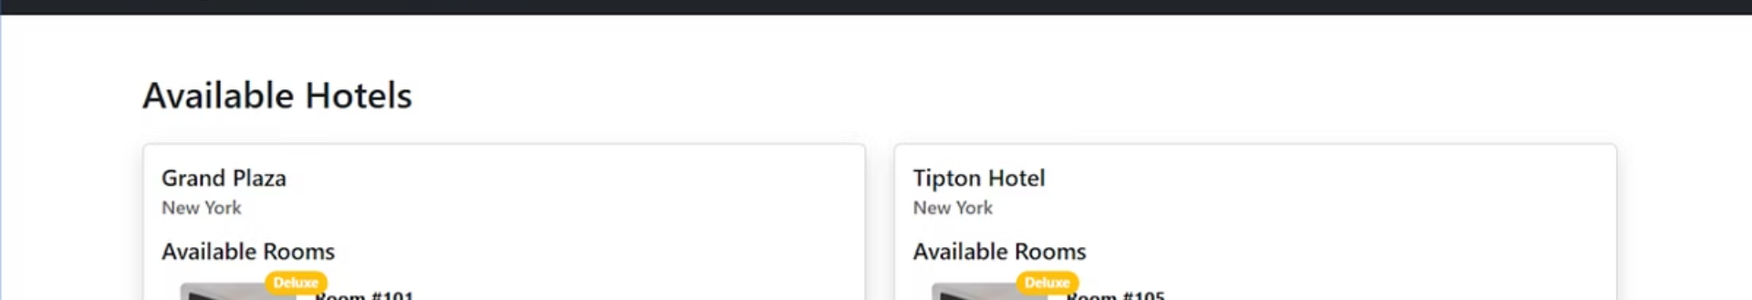





Functional Requirements
Administer Rooms/Hotels
Add/Update Room and Hotel prices and capacities
Book a Room
With optional add-ons
Manage Bookings
View, modify, cancel with notifications
User Accounts
Register/login, loyalty program
Group Bookings
For travel agents

Slide 4

Non-Functional Requirements
Scalability
Independent microservices, containerized
Maintainability
Code must be modular, well documented, and easy to update
Usability
Provide an intuitive, accessible interface on Desktops
Performance
Page-load ≤ 5s under normal load

Slide 5
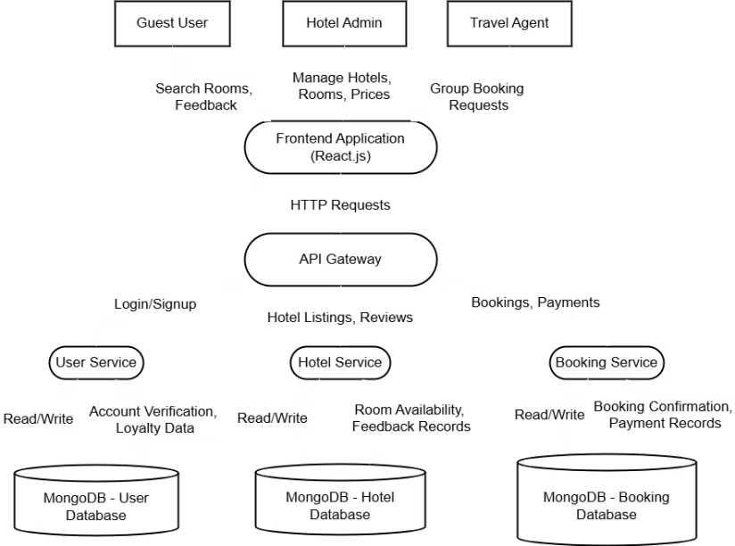
Data-flow Diagram
Class Diagram not suitable since program not based on OOP Principles
Data-flow Diagram instead chosen to represent it

Slide 6
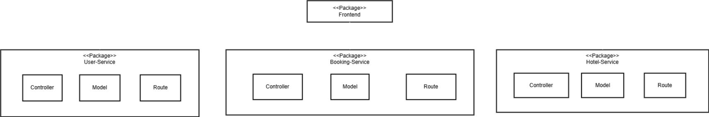
Architecture (Package Diagram)
Microservices Based Architecture
Each Micro-service follows a layered structure:
Controller: Handles logic and validation
Route Layer: Manages request routing
Model Layer: Defines and interacts with MongoDB collections

Slide 7
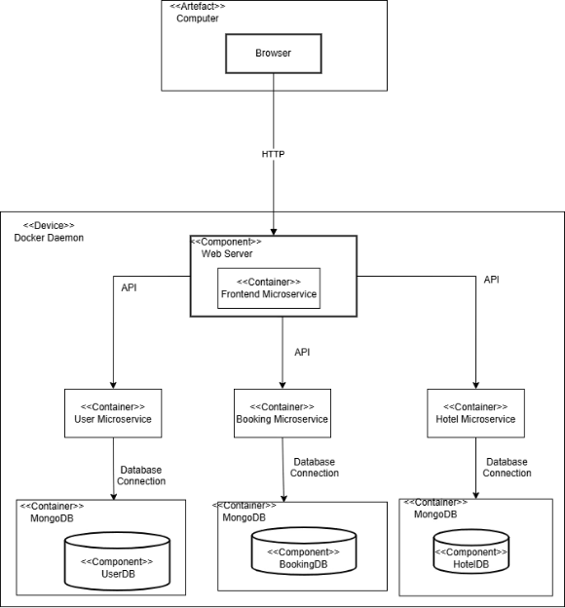
Deployment Diagram
To further understand the workings of the program architecture

Slide 8
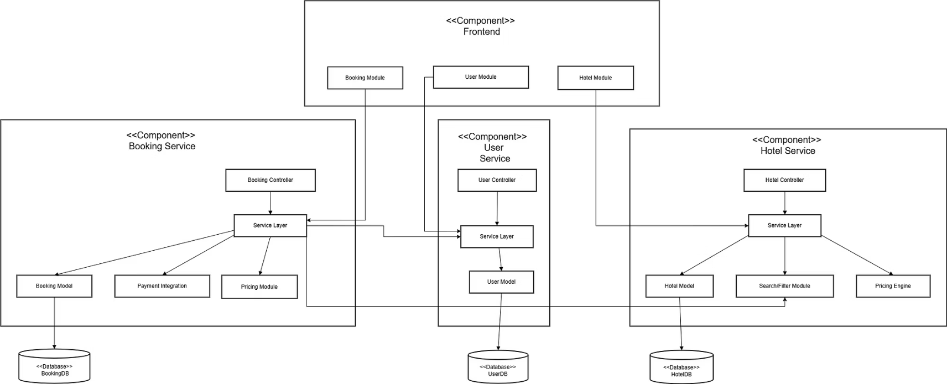
Component Diagram

Slide 9


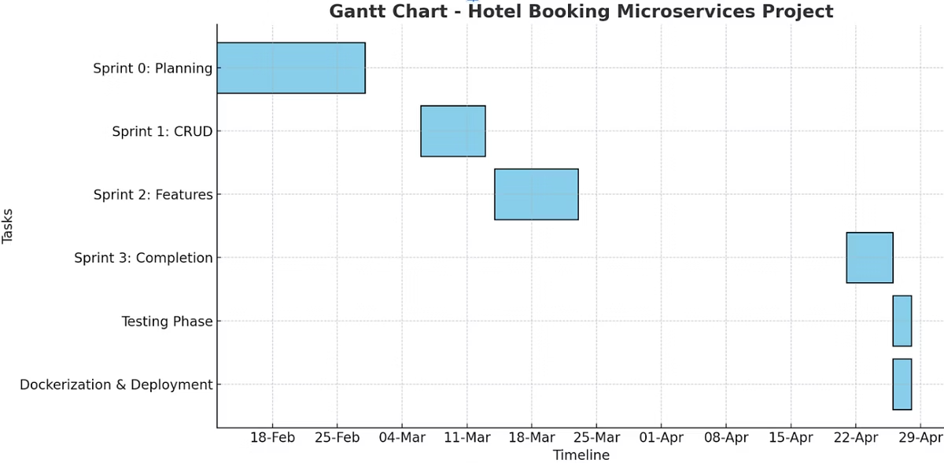


Project Planner
Planning & Setup
Feb 12–28
Sprint 1 & 2
Mar 6–23
User login, basic booking
Search, pricing, manage bookings
Sprint 3 & Testing
Apr 21–28
Payments, group bookings, reporting

Slide 10
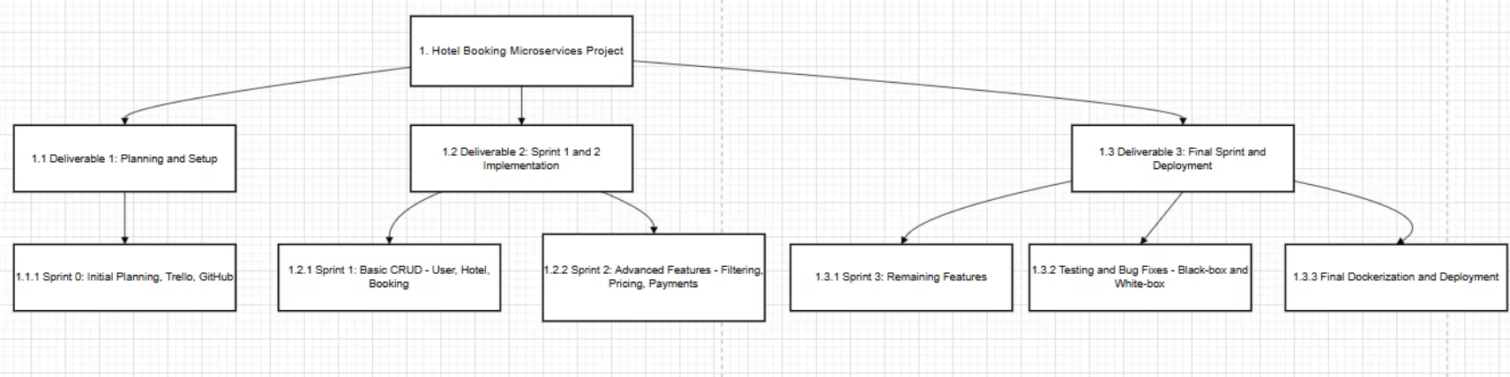
Work Breakdown Structure

Slide 11
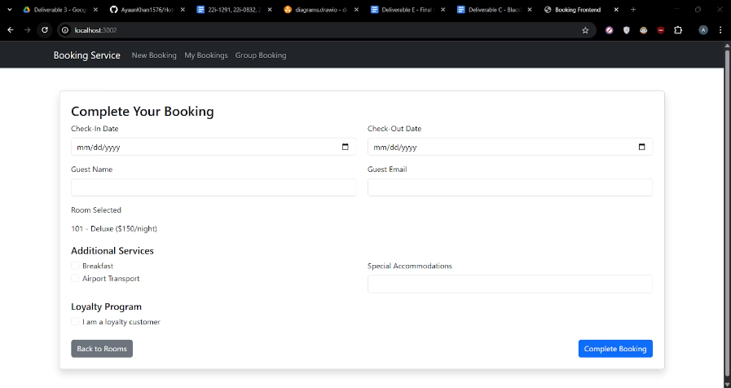
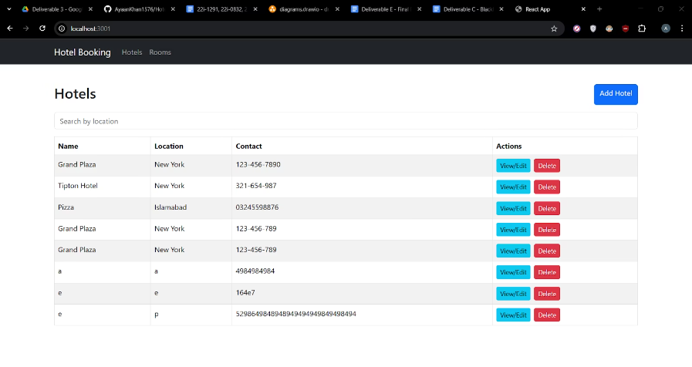
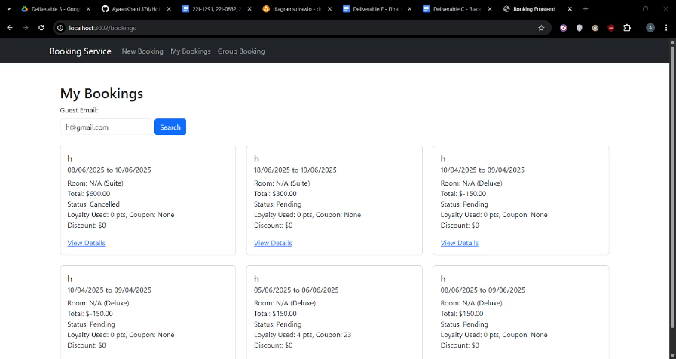
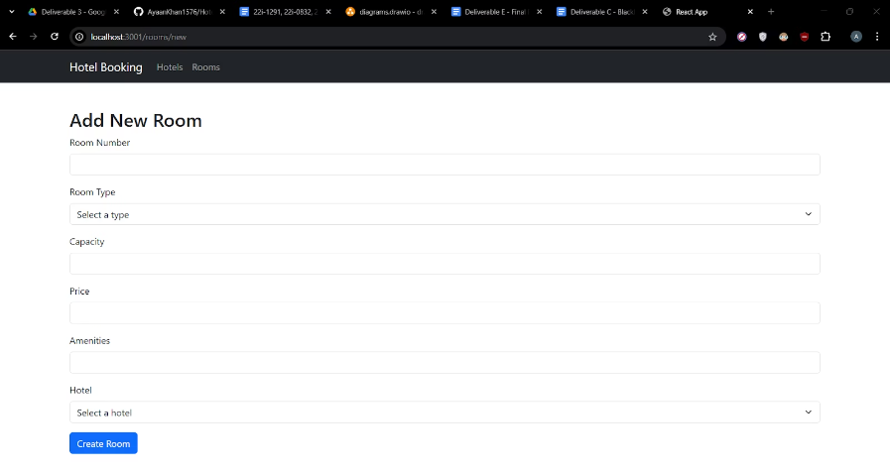
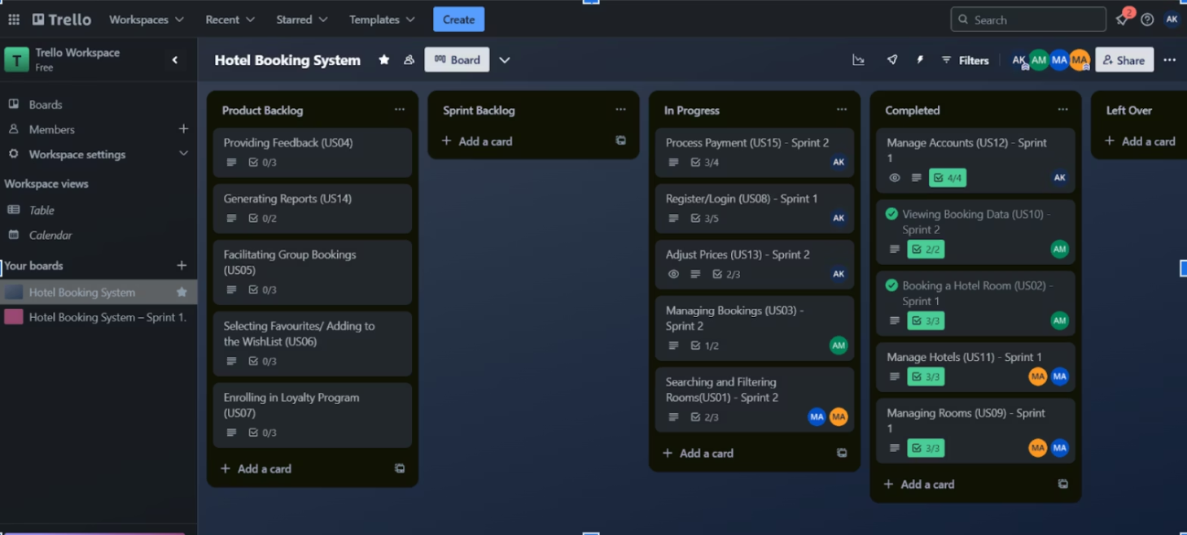
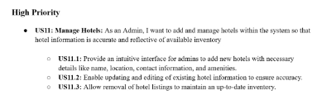
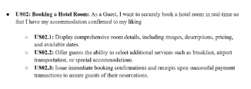
User Stories
US02
US11
Booking a Room
Manage Hotels
Secure, real-time with add-ons
CRUD operations on Hotels to maintain catalogue
US01
US13
Search & Filter
Adjust Prices
Location, dates, amenities, sort
Real-time pricing rules updates
Trello Board with Product Backlog
Examples of User Story Format

Slide 12
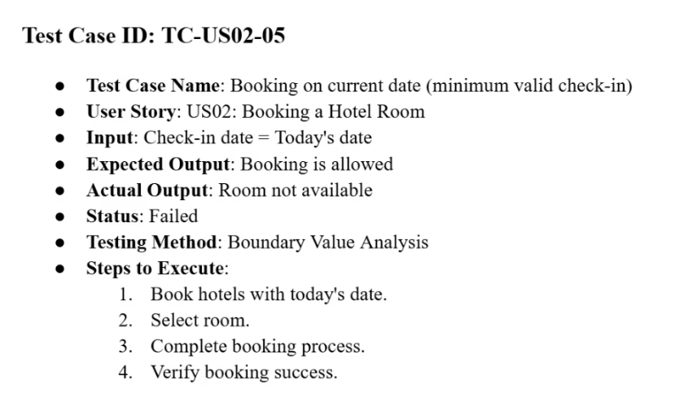
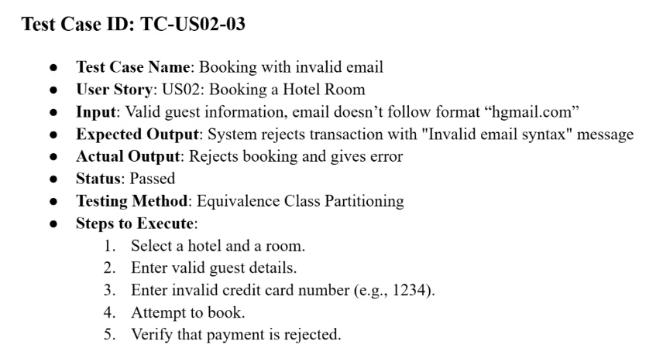
Black-Box Testing
Equivalence Class Partitioning
Boundary Value Analysis
Divide the input space into “equivalence classes” where any one value in the class should behave the same
we focus on the “edges” of each valid interval:
E.g US02 Booking a Hotel Room:
E.g US02 Booking a Hotel Room:
Check-in / Check-out dates:
Valid email format: "name@email.com"
Just inside availability (e.g. first available date and last available date)
Invalid email format: Any email not in correct syntax
Just outside availability (day before first or day after last)

Slide 13
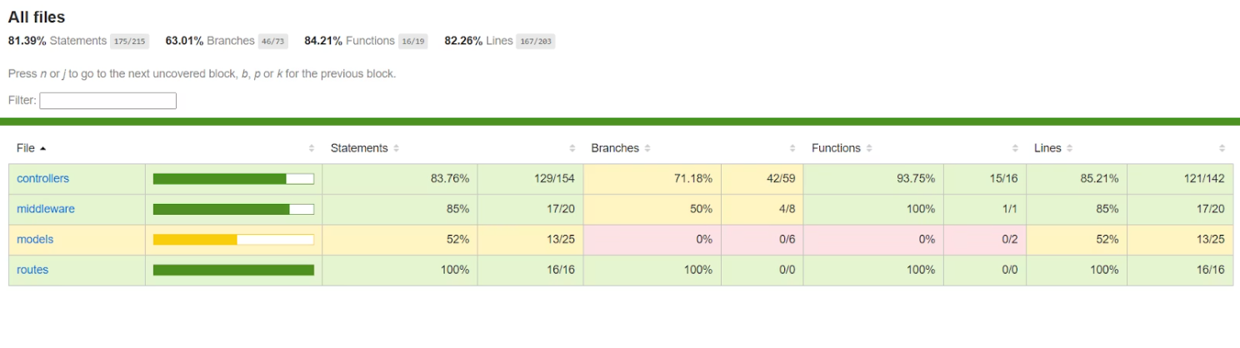
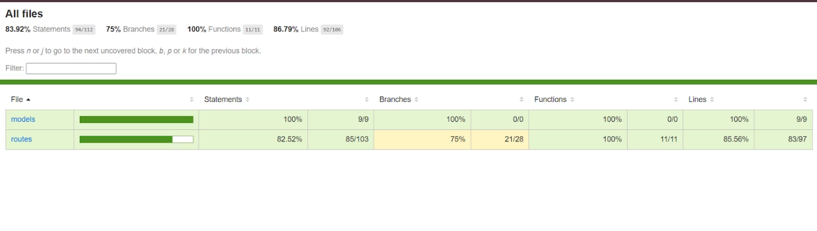
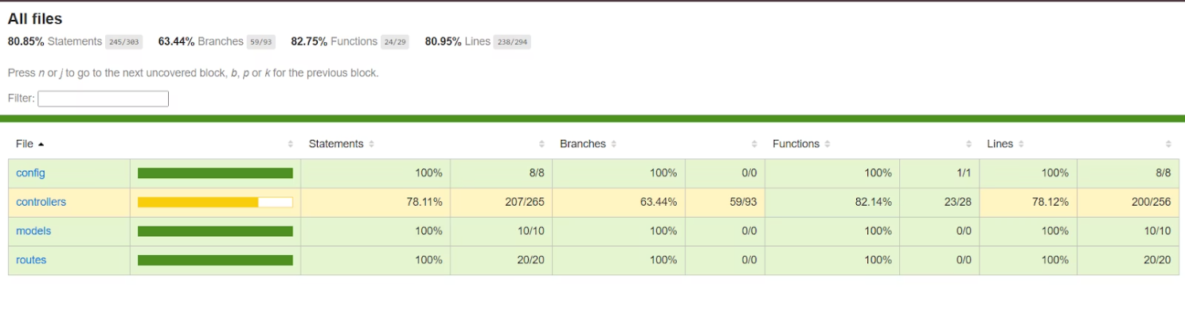
White-Box Testing
Performed on all backend microservices (User, Hotel, Booking)
Used Jest for unit tests and Supertest for endpoint/integration tests
All Services achieved MORE than 80% Coverage
Focused on exercising internal logic, data flows, and error branches
What IS Covered
What is NOT Covered
Core Business Logic
Third-Party Libraries
Branch Coverage
Frontend
Function & Statement Coverage
External Service Failures
API Endpoints
Cron Jobs
User Service:
Hotel Service
Booking Service

Slide 14
Work Division
All Version Control done via Github and Project Management done via Trello
Ayaan Khan
Ayaan Mughal
Mishal Ali
Scrum Master, Tester
UI Designer, Developer
Requirements Architect, Developer
5 User-Service User Stories
5 Booking-Service User Stories
5 Hotel-Service User Stories
Blackbox and Whitebox Testing
Responsible for Frontend Development
Responsible for Frontend Development
Setting up Trello board and structure
Undertook Services Integration
Undertook Requirements analysis
Documentation
Documentation
Documentation

Slide 15
Further Improvements
Project security can be improved so that users cannot abuse bugs to access out of role functions
More functionality can be added to enhance user experience
Deployed via Kubernetes and incorporate CI/CD pipelines for Scalability and Maintainability
Add support for other devices
Test Frontend via End-to-end (Cypress) automated UI tests

Slide 16
Conclusions and Lessons Learned
What Went Well:
Clear sprint goals, rapid prototyping with React & Express
Major User Stories implemented on the backend
Work Division was seamless and well coordinated
Version control implemented well so no problem with rolling back or updating
Challenges:
Integration testing across microservices
Frontend integration with backend
Ensuring > 70% white-box coverage under time pressure
Figuring out right diagrams or schemas to use for a non-OOP project
Takeaways:
Importance of automated tests early on
Start work early so to not be overburdened near deadlines
Learned the importance of requirements analysis in figuring out what to program
Found that mocking external calls (Mongoose, Axios) speeds up tests and keeps them deterministic—but real integration tests against a staging DB are still invaluable for end-to-end confidence.
Testing while development would aide more in bug fixing instead of testing the entire program at once at the end

